Slide 1
Intrusion Detection
Hands-on session
Tatras Data Science Team

Slide 2
Overview
Exploratory Data Analysis
Data Pre-processing
Feature engineering
Stratified Sampling for train-test split
Handling the class imbalance

Slide 3
Overview
Binary classification
Naive Bayes
Logistic Regression
Support vector machines
Decision Trees
Random Forests
Gradient Boosted Decision Trees
Evaluation
Accuracy, Precision, Recall, ROC curve, Confusion matrix, F1 score

Slide 4
Overview
Multi-class classification
Naive Bayes
Logistic Regression
Support vector machines
Decision Trees
Random Forests
Gradient Boosted Decision Trees
Evaluation
Accuracy, Precision, Recall, ROC curve - AUC, Confusion matrix, F1 score
Hyperparameter tuning using GridSearchCV
Cost based algorithms
Multi class classification using ‘one-vs-one’ and ‘one-vs-all’ algorithms

Slide 5
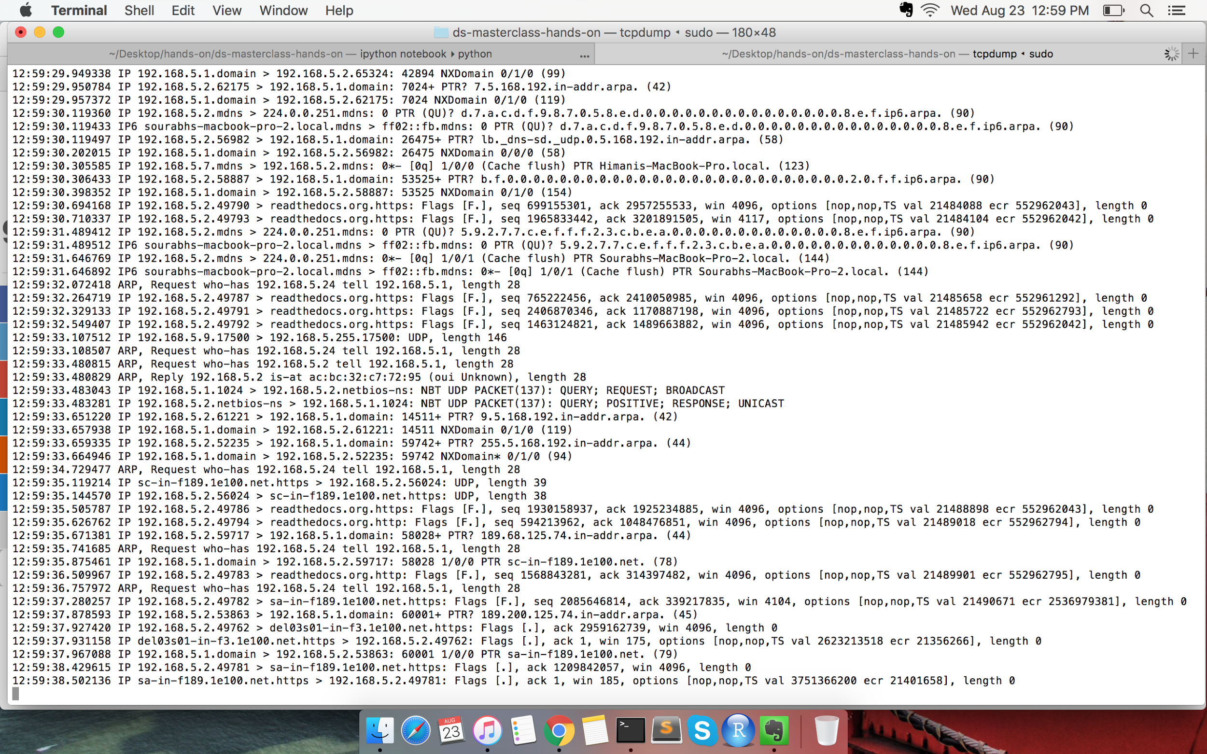
Raw tcpdump

Slide 6
Engineered features using domain knowledge
TCP stats
Duration
Protocol_type
Service
Flag
Land
Wrong_fragment
Urgent

Slide 7
Engineered features using domain knowledge
Content based features
hot
num_failed_logins
logged_in
num_compromised
root_shell
su_attempted
num_root
num_file_creations
Num_shells
Num_access_fies
Num_outbound_cmds
Is_hot_login
Is_guest_login

Slide 8
Engineered features using domain knowledge
Same Host and Same Service
Count
Serror_rate
Rerror_rate
Same_srv_rate
Diff_srv_rate
Srv_count
Srv_serror_rate
Srv_rerror_rate
Srv_diff_host_rate

Slide 9
Engineered features using domain knowledge
Destination Host
Dst_host_count
Dst_host_srv_count
Dst_host_same_srv_rate
Dst_host_diff_srv_rate
Dst_host_same_src_port_rate
Dst_host_srv_diff_host_rate
Dst_host_serror_rate
Dst_host_srv_serror_rate
Dst_host_rerror_rate
dst_host_srv_rerror_rate

Slide 10
Data Exploration
Feature Engineering
Modelling
Model Tuning
Evaluation
Missing data imputation
Distribution of features
Creating new features
Normalizing data
Feature scaling
Standalone Models
Ensembles
Overfitting/Underfitting
Hyper parameter tuning
Accuracy
Precision
Recall
AUC
Confusion Matrix

Slide 11
Few pointers and more ideas
Your choice of evaluation metric can bias your results and interpretation.
Overfitting/Underfitting
Data normalization
Separate features sets for predicting different classes of attacks
Optimize each binary classifier under the hood.

Slide 12
Resources and References
http://www.kdd.org/kdd-cup/view/kdd-cup-1999/Tasks
https://www3.nd.edu/~dial/publications/chawla2004editorial.pdf

